Slide 1
Solving Minesweeper with AI: A Hybrid Approach Using logic and probability
Jones, John K
Muthukumarasamy, ShankaraNarayanan
Shu, Alex Banchao
Foundations of AI (Spring, 2025)

Slide 2
Background
A Minesweeper AI player can be designed to play Minesweeper efficiently without human interface, minimizing mistakes and maximizing success. High-success-rate AI players employ various techniques, including logic techniques and probability inference.
The logic techniques including propositional logic, constrain satisfaction problem, and heuristic algorithms to label the safe cells and identify mines.
When there is no logic move left, we employee the probability analysis including Bayesian Network, and Monte Carlo Simulation to decide the safe move.

Slide 3
2. Challenges
Build an AI player using propositional logic
Improving the AI performance and efficiency
Improve how it makes decisions, and help it figure the game better.
Come up with better ways to handle conflicts so it does not get stuck.
Speed up its decision-making with better methods
Enable the AI’s adaptability to pick the best moves using heuristics and probabilities instead of guessing.
Help make the AI more adaptable and learn from advanced logic and strategies at solving the game.

Slide 4
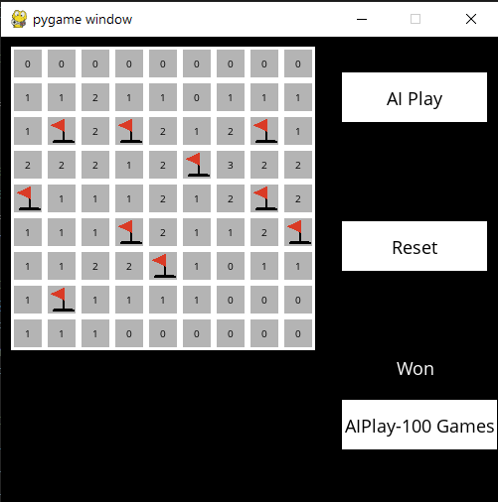
3. Overview of Solution / Contributions
Instructions for Use
Start the game by triggering the AI to play. AI Play is a single play, if we need winning odds we can use AIPlay-100 games.
The AI will perform an initial safe move.
The AI continues to play by applying logical reasoning or probabilistic models when necessary.
The final result (win/loss) is displayed at the end of the game.
To play again, reset the game board.

Slide 5
4. AI Model(s)
Propositional Logic for safe and mine deduction.
Constrain Satisfaction Problem to infer additional knowledge.
Heuristic Algorithm for overlap inference of mines.
Bayesian Inference to estimate risk.
Monte Carlo Simulation for probabilistic decision-making.

Slide 6
Propositional Logic
Two key rules:
1. If the number of unknown cells = the number of mines, then all those cells are mines.
A ∨ B ∨ C, and count = 3 ⇒ A ∧ B ∧ C are all mines.
2. If count = 0, then all cells are safe.
¬A ∧ ¬B ∧ ¬C (none are mines).
Condition | Logical Form | Interpretation
count == 0 | ∀x ∈ cells, ¬M(x) | All are safe
len(cells) == count | ∀x ∈ cells, M(x) | All are mines
This propositional logic is deterministic and allows for definite safe/mine deductions without probabilities

Slide 7
Constrain Satisfaction Problem
Constraint Satisfaction Problem (CSP) logic to deduce new safe cells or mines by reasoning over the knowledge base.
Condition | Logical Form | Interpretation
S1 ⊂ S2 | S2 – S1 = c2 - c1 | Deduce subset sentence from the main sentence
count == 0 | ∀x ∈ cells, ¬M(x) | All are safe
len(cells) == count | ∀x ∈ cells, M(x) | All are mines

Slide 8
Heuristic Algorithm
The partial_overlap_inference() function in your MinesweeperAI is designed to apply propositional logic on partially overlapping sentences. If both sentences are true, their overlap contributes to both counts, so we subtract it twice to avoid double-counting.
Example
{A, B, C} = 2 → Two of these are mines
{B, C, D} = 2 → Two of these are mines
Their overlap is {B, C} Their unique parts are {A} and {D}
New sentence: {A, D} = 0, So A and D must be safe.
Condition | Logical Form | Interpretation
S1 & S2 overlap | New_cells = (S1 \ S2) ∪ ( S2 ∖ S1) New_count = c1 + c2− 2 x (overlap) New_sentence = new_cells⇒new_count | Deduce new sentence from overlap
count == 0 or count == 1 | ∀x ∈ cells, ¬M(x) | All are safe
len(cells) == count | ∀x ∈ cells, M(x) | All are mines

Slide 9
Bayesian Reasoning
In the bayesian_inference method of the MinesweeperAI class, the code uses a simplified Bayesian-style heuristic.
Formula in Code
cell_probs[cell] = (cell_probs[cell] + likelihood)/2
This is a weighted average of:
A prior probability of the cell being a mine:
prior = remaining mines / unrevealed cells
A likelihood estimate based on knowledge sentences:
likelihood for cell = count / number of unknown cells in sentence
Each cell’s probability is updated by averaging this likelihood with the prior.
The Final Safe Move is decided by the cell with minimal probability to be a mine.
safe_move = min (cell_probs[unreveal(cell)])

Slide 10
Monte Carlo Simulation
The Monte Carlo simulation to estimate the safest cell to click based on the knowledge when no deterministic (logic-based) move is possible.
Choose the Cell with the Highest Score as the safe cell to make the move. Mote Carlo is only used at the final steps of the game as it requires more computational power to run 10,000 simulations.
Steps | Purpose
Simulate consistent mine placements 10,000 times with the knowledge | Model uncertainty when logic is insufficient
Count how often each cell is safe | Estimate safety probability
Pick highest-scoring cell | Make the best probabilistic move

Slide 11
Smart Move
Start the Game
make_safe_move()
Click the cell/mark mine
Smart Move is the uplevel algorithm to have the AI agent switch between all different AI techniques to define the safe cells and mines to increase the winning rates.
No safe move
csp_move()
Click the cell/mark mine
No safe move
infer_overlap_mines()
Click the cell/mark mine
No safe move
bayesian_inference()
Click the cell
Bayesian score > 0.8
monte_carlo_search()
Click the cell
10,000 x simulations
Win or Loss

Slide 12
Minesweeper AI Solver Demo

Slide 13



Evaluations – Performance
Minesweeper AI Performance | Beginner | Intermediate | Difficult
Window Size | 9 x 9 | 16 x 16 | 30 x 16
Mines | 10 | 40 | 99
Win Out of 100 Games | 91 | 71 | 22
Beginner
Intermediate
Difficult

Slide 14
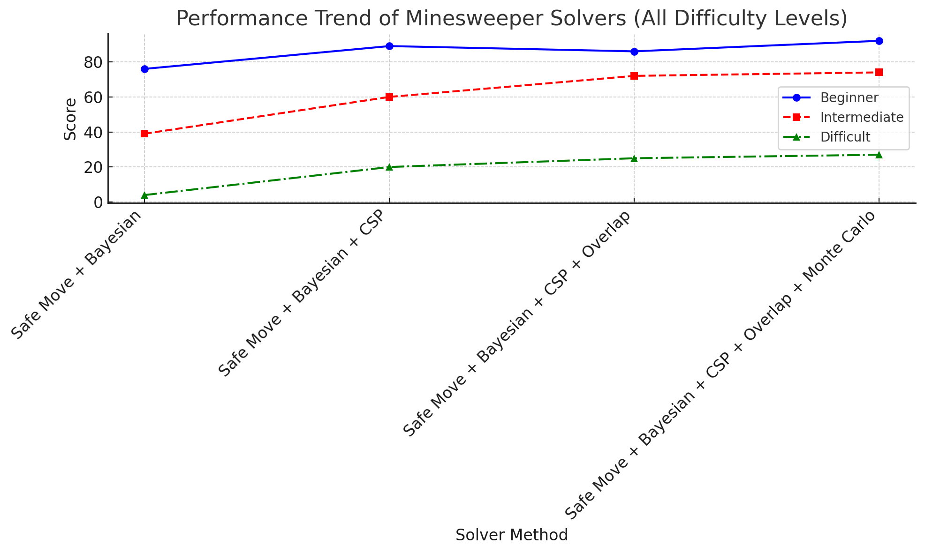
Performance Trend of Minesweeper Solver | Safe Move + Bayesian | Safe Move + Bayesian +CSP | Safe Move + Bayesian +CSP + Over_lap | Safe Move + Bayesian +CSP + Over_lap + Monte Carlo
Beginner | 76 | 89 | 86 | 92
Intermediate | 39 | 60 | 72 | 74
Difficult | 4 | 20 | 25 | 27

Slide 15
Discussion of Results
The winning rates decreases as the game difficulty increases from beginner (91%), to intermediate (71%), to difficult (22%).
Hybrid techniques have improved the winning rate of the game. If we only implement the basic techniques which are Prepositional Logic and Bayesian, the winning rate is low. After we add CSP, Overlapping, and Monte Carlo the winning rate increases at different difficulty levels. At beginner level the winning rate increases from 76% to 92%, at intermediate level the winning rate increases from 39% to 74%, at difficult level the winning rate increases from 4% to 27%

Slide 16
Conclusion
We introduced a Minesweeper AI player with mixed logic techniques and probability inference. The logic techniques including propositional logic, constrain satisfaction problem, and heuristic algorithms to label the safe cells and identify mines. When there is no logic move left, we employee the probability analysis including Bayesian Network, and Monte Carlo Simulation to decide the safe move.
The Minesweeper AI player can reach a winning rate of 92% at the highest. We can now confidently say the AI player is on Par with Human.

Slide 17
Back Up slides
References
Model abstractions etc.
Links

Slide 18
References
1. https://cs50.harvard.edu/summer/ai/2022/projects/1/minesweeper/
2. Becerra, D. J. (2015). Algorithmic approaches to playing Minesweeper (Doctoral dissertation).
3. Kadlac, M. (2003). Explorations of the minesweeper consistency problem. Oregon State University, Research Experiences for Undergraduates.
4. Kaye, R. (2000). "Minesweeper is NP-Complete" – Theoretical complexity of Minesweeper.
5. Mehta, A. (2021). Reinforcement learning for constraint satisfaction game agents (15-puzzle, minesweeper, 2048, and sudoku). arXiv preprint arXiv:2102.06019.
6. Russell, S. J., & Norvig, P. (2016). Artificial intelligence: a modern approach. Pearson. Chapters on logic, CSPs, and probabilistic reasoning.
7. Sebag, M., & Teytaud, O. (2012). Combining myopic optimization and tree search: Application to minesweeper. In LION6, Learning and Intelligent Optimization (Vol. 7219, pp. 222-236). Sringer Verlag.
8. Sinha, Y. P., Malviya, P., & Nayak, R. K. (2021). Fast constraint satisfaction problem and learning-based algorithm for solving Minesweeper. arXiv preprint arXiv:2105.04120.
9. Sutton & Barto, "Reinforcement Learning: An Introduction" (2018) discusses Monte Carlo methods for estimating probabilities.
10. https://www.geeksforgeeks.org/inference-in-ai/

Slide 19
Project Structure
Component | Description
Minesweeper | Represents the game board, mine placement, and game logic.
Sentence | Represents logical statements about sets of cells and mine counts.
MinesweeperAI | Implements the AI agent, including logic inference and decision-making strategies.

